Slide 1
Corn Maze to Increase Agritourism

Slide 2
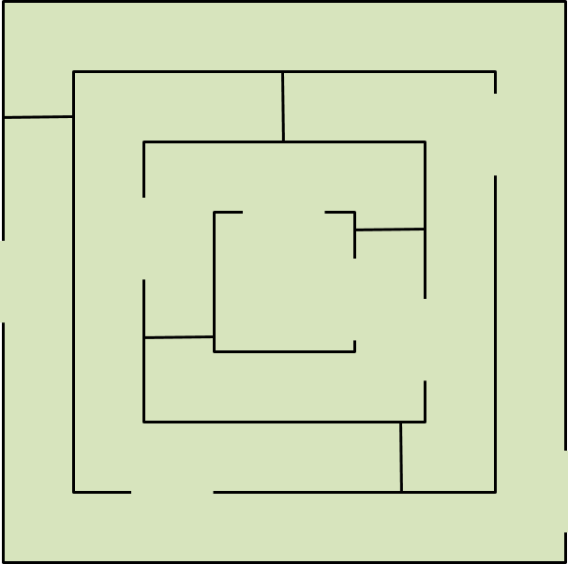

Slide 3
Plan
Design and Build
Operation
Overlooks
Marketing and Insurance
Pricing

Slide 4
Design and Build
Plant later in season
Field will be greener longer
Plan to harvest very late in the fall
Plant in two directions for thicker maze walls
Cut design when plants are one- to two-feet high
DIY—lay out in grid or use GPS
Hire professional maze builders
Keep pathways clear
Mow
Roll and crimp
Use signs in maze
Allow customers to orient selves
Make finding lost items easier

Slide 5
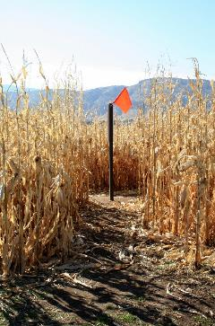
Operation
Create ticketing system
Hand stamps
Wristbands
Hire additional employees
Create parking area
Clearly marked
Consider number of spots needed
Restrooms
Convenient
Need to be clean
Use port-a-johns if needed

Slide 6
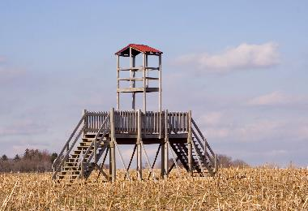
Overlooks
Allows for more complex figure-8 design
Improves customer experience
Allows staff to monitor maze
Customize design to match your maze theme

Slide 7
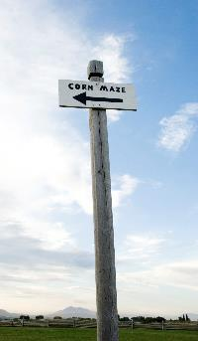
Marketing and Insurance
Advertise
Road signs
Internet
Radio
Newspapers
TV
Insurance
Check with insurance agent
Add a rider if needed

Slide 8
Home Entertainment
Executive Summary
Background
Homeschooled Students in US
Homeschooling Rates by Student
Family Characteristics
Characteristics of Homeschooled Students
Characteristics of Nonhomeschooled Students
Parents’ Reasons for Homeschooling

Slide 9
Pricing
$
Research competition in area
Factor in cost of land use
Can still harvest corn, especially for silage
Expect 20-25% loss because of pathways
Average season is 6-7 weeks
Establish entrance fee
Per person
Per family
Consider value pricing
Package prices with other attractions
Group prices

Slide 10
Tips
Don’t underestimate importance of creating a budget
Marketing is crucial
Vary themes each year to encourage repeat visits
Be prepared to transplant for areas that get damaged

